Slide 1
Descriptive and inferential statistical methodologies have proven effective in creating a proactive ‘alarm’, accurately identifying Pump Failures with Horse Power (HP) and Pump Efficiency (PE) emerging as key variables of interest with deviations of 15 HP and > 3 % PE being our core signal thresholds.
PUMP FAILURE (1 or 0)
Raw Data | Correlation Coefficient
Volumetric Flow Meter 2 | -0.11211472
Pump Efficiency | -0.102684351
Volumetric Flow Meter 1 | -0.102508317
Ambient Temperature | 0.20794584
Pump Torque | 0.233192706
Pump Speed (RPM) | 0.260016062
Horse-Power | 0.421844074
PUMP FAILURE (1 or 0) | Rolling Mean (30 Minute) Correlation Coefficient
Volumetric Flow Meter 2 | -0.697731416
Pump Efficiency | -0.695027831
Volumetric Flow Meter 1 | -0.692425138
Ambient Temperature | -0.302615535
Pump Torque | -0.215937441
Pump Speed (RPM) | -0.184159622
Horse-Power | 0.218050641
PUMP FAILURE (1 or 0)
Rolling Stdev (30 Minute) | Correlation Coefficient
Pump Torque | 0.597260414
Ambient Temperature | 0.600050431
Pump Speed (RPM) | 0.624555908
Volumetric Flow Meter 2 | 0.625920871
Pump Efficiency | 0.64
Volumetric Flow Meter 1 | 0.64
Horse Power | 0.69

Slide 2
Descriptive Analysis has enabled us to clearly identify particular signature abnormalities showing clear signature changes in both Rolling Standard Deviation and Rolling Mean Datasets when observed over the respective failure period of interest.

Slide 3
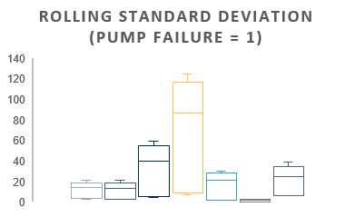
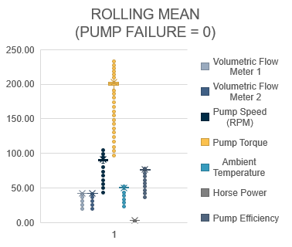
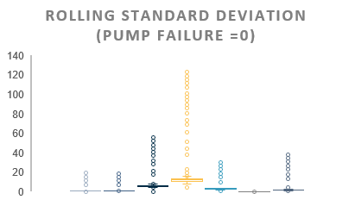
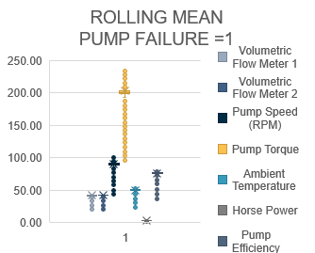
Plots show a clear signature difference between that of normal behaviour and that of Failure with pump torque, pump speed, and pump efficiency showing the 3 largest variances.

Slide 4
Correlation analyses across datasets yield particularly interesting insights with pump efficiency and Volumetric Flow Meter 1 negatively correlated with Pump Failure in the Rolling Mean Data, whilst pump efficiency and Volumetric Flow Meter 1 show a subsequently strong positive correlation in the Rolling STDEV Dataset.

Slide 5
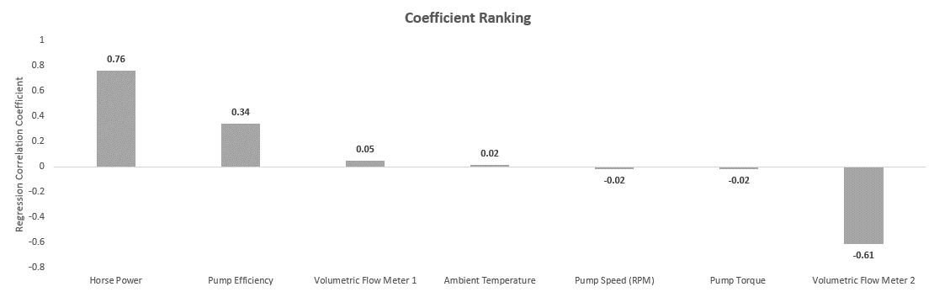
Lastly, analysis of the statistical significance of variables contributing towards Pump Failure reveal that with a R Squared of 0.778, a linear model is a good fit for the data with both Rolling Mean and Rolling Standard Deviation datasets contributing key information to understand Pump Failure mechanics.
Variable | P-Value Significance
Horse Power | 3.5524E-219
Volumetric Flow Meter 2 | 2.033E-174
Pump Efficiency | 2.592E-152
Pump Torque | 1.0551E-102
Intercept | 8.27258E-24
Pump Speed (RPM) | 1.68299E-19
Ambient Temperature | 4.20516E-09
Volumetric Flow Meter 1 | 4.01554E-07

